Slide 1
Faster fonts
Web Performance Optimization
Unit-4

Slide 2
This chapter covers
Limiting the number of fonts through selection
Rolling your own @font-face cascade
Understanding the benefits of server compression for older font formats
Limiting the size of fonts by subsetting
Using the unicode-range CSS property to serve font subsets
Managing the loading of fonts through JavaScript APIs

Slide 3
Using fonts wisely
An optimal use of fonts begins with selection.
Although font providers such as Google Fonts and Adobe Typekit do a lot to guide you in selecting fonts, at times you’ll need to host fonts yourself—either because the font you need isn’t available on these services, or your client has specific requirements that may prohibit you from using them.
Before you start, you need to download the client’s site and run it locally with these commands:
git clone https://github.com/webopt/ch7-fonts.git
cd ch7-fonts
npm install
node http.js

Slide 4
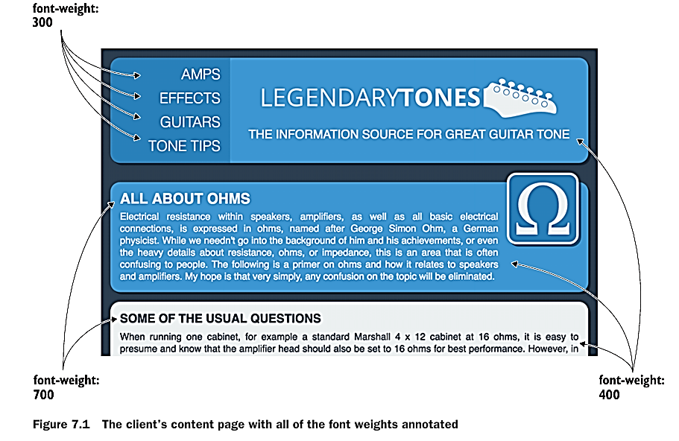
Selecting fonts and font variants
At a glance, the client’s website design could be improved by adding fonts. The designer on the project has recommended a nice sans serif font named Open Sans. To help out, the designer placed the Open Sans font family in a subfolder of the css folder named open-sans. A glance into this folder reveals 10 styles.

Slide 5
Different web Font Formats comparison
TrueType Font (TTF), Embedded OpenType (EOT), Web Open Font Format (WOFF), and WOFF2 are all font formats used on the web. Each format has its own characteristics and advantages:
1. TTF (TrueType Font):
TTF is one of the oldest font formats, developed by Apple and Microsoft in the late 1980s.
It's widely supported across different platforms and browsers.
TTF fonts can be used directly in CSS @font-face declarations.
2. EOT (Embedded OpenType):
EOT was developed by Microsoft as a solution to licensing and security concerns.
It's specifically designed for use on the web and can include DRM (Digital Rights Management) information.
EOT is now less commonly used, as its use was primarily tied to older versions of Internet Explorer which had limited support for other font formats.

Slide 6
Different web Font Formats comparison…
WOFF (Web Open Font Format):
WOFF was developed by Mozilla in collaboration with other organizations.
It's a compressed font format designed specifically for web use.
WOFF provides better compression than TTF and EOT, leading to faster page loading times.
It has widespread support across modern browsers.
WOFF2 (Web Open Font Format 2):
WOFF2 is an improved version of WOFF, developed by Google.
It offers even better compression compared to WOFF, resulting in smaller file sizes and faster loading times.
WOFF2 is supported by most modern browsers, but some older browsers may not support it.

Slide 7
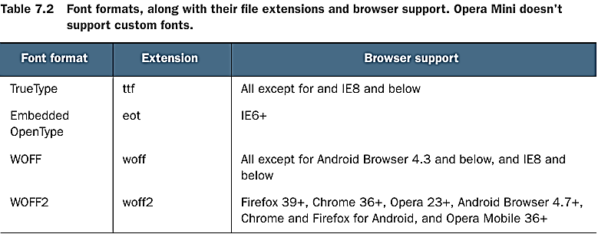
Rolling your own @font-face cascade
With your font variants identified and the corresponding font files selected, you can begin embedding them into the client’s website. But before you can write your @font face declarations, you need to convert the TrueType font files to the other formats that you need. Because you have only the TrueType (TTF) fonts for Open Sans available, you need to convert them to the three other formats you need.

Slide 8
You can use various tools, available as web services or via download, for conversion.
Conveniently enough, you can acquire some command-line utilities with npm.
These are as follows:
ttf2eot—Converts TTF to Embedded OpenType (EOT)
ttf2woff—Converts TTF to WOFF
ttf2woff2—Converts TTF to WOFF2
To install these utilities globally so that you can use them anywhere on your system, you run this command:
npm install -g ttf2eot ttf2woff ttf2woff2
navigate to the directory containing your TrueType Font (TTF) file in VSCode.
Use the ttf2woff2 command followed by the name of your TTF file to convert it to WOFF2 format.
For example: ttf2woff2 myfont.ttf

Slide 9
BUILDING THE @FONT-FACE CASCADE
How you build the @font-face cascade is important.
The @font-face CSS at-rule specifies a custom font with which to display text; the font can be loaded from either a remote server or a locally-installed font on the user's own computer.
When done right, it hints to the browser which formats are available and provides the optimal format.
For modern browsers, you can reap the benefits of highly compressed formats such as WOFF and WOFF2, and for older browsers, you can safely fall back to less-optimal EOT and TTF formats.
Let’s get started with writing the @font-face code by opening styles.css in the css folder.
The following listing shows the @font-face code for the first font you need, which is the regular font weight for Open Sans.
You’ll want to place this at the start of styles.css.

Slide 10
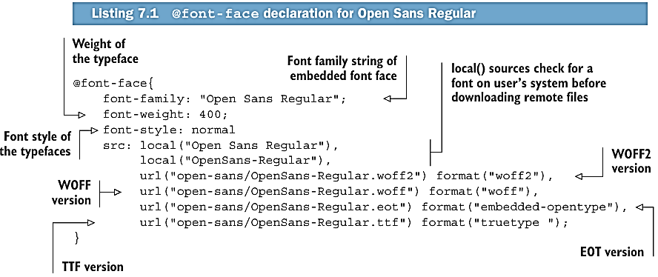

Slide 11
Syntax:
@font-face {
font-family: "Trickster";
src:
local("Trickster"),
url("trickster-COLRv1.otf") format("opentype") tech(color-COLRv1),
url("trickster-outline.otf") format("opentype"),
url("trickster-outline.woff") format("woff");
}

Slide 12
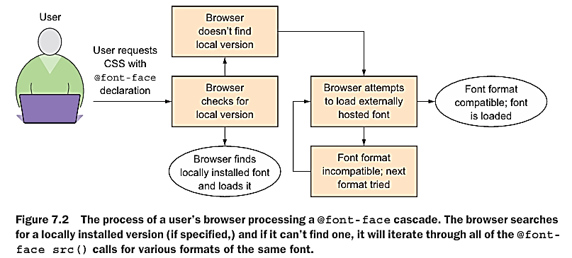

Slide 13
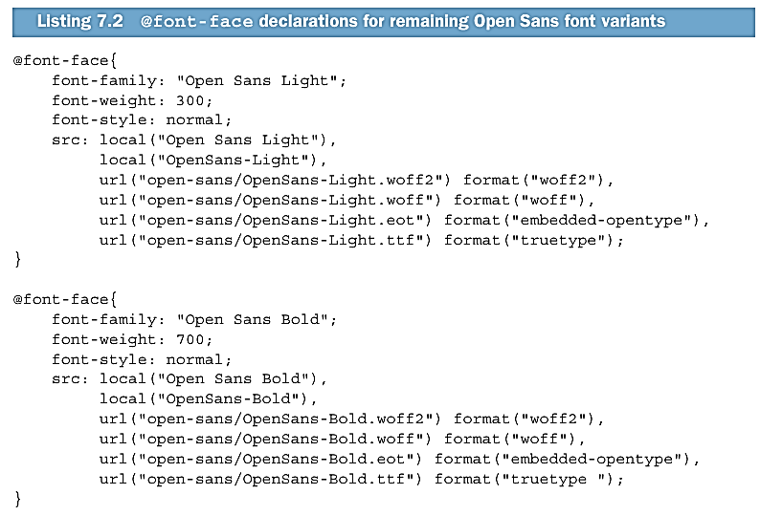

Slide 14
Downloading fonts
Google Fonts (fonts.google.com) is a great resource for downloading free fonts for web use. One popular and versatile font you might consider is "Open Sans." It's widely used and works well for various types of content due to its clean and modern design.
Here's how you can use "Open Sans“ or any other font in your web project:
Visit the Google Fonts website.
Search for "Open Sans“ or any other desired font in the search bar.
Once you find it, Download it.
Create a new folder in your project for font and Place downloaded font in it.
Use "Open Sans“/desired font in your CSS styles by specifying @font-face rule font-family: 'Open Sans’/desired font, sans-serif;.

Slide 15
Ex. Index.html
<!DOCTYPE html>
<html lang="en">
<head>
<meta charset="UTF-8">
<meta name="viewport" content="width=device-width, initial-scale=1.0">
<title>Custom Fonts Example</title>
<link rel="stylesheet" href="styles.css">
</head>
<body>
<h1>Welcome to Custom Fonts Example</h1>
<p>This is a paragraph demonstrating the use of custom fonts.</p>
</body>
</html>

Slide 16
styles.css
@font-face {
font-family: 'NotoSerif';
src: url('fonts/NotoSerif-Italic-VariableFont_wdth\,wght.woff2') format('woff2'), /* WOFF2 format */ Local path of font in your project
url('fonts/NotoSerif-Italic-VariableFont_wdth\,wght.woff') format('woff'), /* WOFF format */
url('fonts/NotoSerif-Italic-VariableFont_wdth\,wght.ttf') format('truetype'); /* TTF format */
}
@font-face {
font-family: 'NotoSerif-ExtraBold';
src: url('fonts/static/NotoSerif-ExtraBold.woff2') format('woff2'), /* WOFF2 format */
url('fonts/static/NotoSerif-ExtraBold.woff') format('woff'), /* WOFF format */
url('fonts/static/NotoSerif-ExtraBold.ttf') format('truetype'); /* TTF format */
}
body {
font-family: 'NotoSerif', sans-serif;
}
h1 {
font-family: 'NotoSerif-ExtraBold', sans-serif;
}

Slide 17
Compressing EOT and TTF font formats
Compressing EOT (Embedded OpenType) and TTF (TrueType Font) formats is a common practice in web development to optimize performance.
By reducing the file size of fonts, you can improve loading times and overall site performance.
Here are some techniques for compressing EOT and TTF font formats:
Font Subset: Often, web developers only need a subset of characters from a font. By generating a subset containing only the characters necessary for your website, you can significantly reduce the file size. There are online tools and libraries available that can help you generate subsets of fonts.
FontForge: FontForge is a free and open-source font editor that allows you to edit, create, and convert font files. You can use FontForge to optimize and compress font files by removing unnecessary glyphs, adjusting font metrics, and optimizing font outlines.

Slide 18
Compression Tools: Utilize compression tools (algorithm) like Zopfli, Brotli, or Gzip to compress font files. These tools can further reduce the file size of EOT and TTF font files without losing quality. When serving font files from your web server, make sure that compression is enabled to deliver compressed font files to clients.
Font Format Conversion: Convert fonts to more efficient formats like WOFF (Web Open Font Format) and WOFF2. WOFF and WOFF2 are compressed font formats specifically designed for web use, offering better compression and improved loading times compared to EOT and TTF formats.
Minification: Minify CSS files that reference fonts to remove unnecessary whitespace, comments, and line breaks. This can reduce the overall size of your CSS files and improve loading times.
CDN Hosting: Host your font files on a Content Delivery Network (CDN) that supports compression and efficient delivery of static assets. CDNs can help distribute font files to users globally and deliver them quickly by caching files closer to the end-users.
Optimize Loading: Use asynchronous loading techniques for fonts to prevent blocking the rendering of your web pages. You can load fonts asynchronously using JavaScript or by utilizing the font-display CSS property to control font loading behavior.

Slide 19
You may recall that your @font-face cascade starts off fine with high-performing formats such as WOFF2 and WOFF. But the two formats after that, although well-supported, are less optimal. The reason behind this is that the WOFF2 and WOFF formats are internally compressed. A compression algorithm is internal to those formats, and server compression isn’t necessary.
TTF and EOT font formats aren’t compressed, so they’re great candidates for server compression. Server compression can carry overhead for binary file types, but the process is worth it to speed the delivery of these less-optimized formats.

Slide 20
Subsetting fonts
The unfortunate reality of adding fonts to any site is that more data is going to end up being transferred over the wire.
By adding three fonts, you’ve added around 185 KB of extra weight on browsers that download the WOFF2 fonts.
Less-capable browsers fall back to WOFF, and other versions that represent approximately 260 KB of extra data. That’s a lot, and there must be a way to trim the fat.
Fortunately, you can use a technique to reduce font size: subsetting. Subsetting fonts is a technique used in web development to optimize web performance by including only the necessary characters and glyphs required for a particular website or web application.
This process reduces the file size of font files, resulting in faster loading times and improved performance. Let's delve into the details of subsetting fonts:.

Slide 21
What is Subsetting?
Subsetting involves selecting and including only a subset of characters and glyphs from a font file that are needed for a specific purpose, such as displaying text content on a website.
Many fonts contain a wide range of characters, symbols, and glyphs, including those for languages, punctuation, and special characters that may not be used on a particular website.

Slide 22
Why Subsetting is Important for Web Performance Optimization?
Reduced File Size: Including only the necessary characters and glyphs significantly reduces the file size of font files. Smaller file sizes result in faster downloads and reduced bandwidth consumption, especially for users accessing the website on mobile devices or with slower internet connections.
Faster Load Times: Smaller font files load more quickly, leading to faster overall page load times. This is particularly important for improving the perceived performance of a website and enhancing user experience.
Bandwidth Savings: By reducing the size of font files, subsetting helps conserve bandwidth, which is beneficial for both website visitors and website owners, especially on websites with high traffic volumes.

Slide 23
Techniques for Subsetting Fonts:
Identify Required Characters: Determine which characters and glyphs are necessary for your website or web application. This typically includes letters, numbers, punctuation marks, symbols, and special characters used in the content and design elements of your site.
Use Online Tools: There are several online tools and services available that facilitate font subsetting. These tools allow you to specify the characters and glyphs you need and generate a subset of the font file containing only those characters. Some popular tools include Font Squirrel's Webfont Generator, Glyphhanger (npm install -g glyphhanger), and Transfonter.
Font Editing Software: Advanced users can use font editing software like FontForge or Glyphs to manually subset fonts. These tools provide more control over the subsetting process and allow you to customize which characters and glyphs are included in the subset.
CSS @font-face Rule: When using the @font-face rule to embed custom fonts in your CSS, you can specify a subset of characters using the unicode-range descriptor. This ensures that only the specified characters are downloaded and rendered by the browser, further optimizing font loading and performance.

Slide 24
Glyphhanger — a tool to subset and optimize fonts
Glyphhanger is a tool used for subsetting web fonts.
Subsetting involves selecting only the characters needed for a particular web page, which can help reduce the file size of the font, thus improving performance.
Glyphhanger can be particularly useful for web developers who want to optimize font loading on their websites.

Slide 25
To use Glyphhanger for subsetting, follow these general steps:
Install Glyphhanger: You can install Glyphhanger using npm (Node Package Manager) by running the following command in your terminal:
npm install -g glyphhanger
Run Glyphhanger: Navigate to your project directory in the terminal and run Glyphhanger with the following command:
glyphhanger <url>
Review Subset: Glyphhanger will generate a subset of the font files used on the web page and output them. Review the generated subset to ensure it includes all the necessary characters for your web page.
Use Subsetted Fonts: Once you're satisfied with the subset, integrate the subsetted font files into your web project. You'll need to update your CSS to point to the subsetted font files rather than the original ones.
Test: Test your web page to ensure that the subsetted fonts are displaying correctly and that all necessary characters are included.

Slide 26
Example. Let's say you have a website with a web font imported like this in your CSS:
@font-face {
font-family: 'Roboto';
src: url('Roboto-Regular.woff2') format('woff2'),
url('Roboto-Regular.woff') format('woff');
font-weight: normal;
font-style: normal;
}
Now, subset this font to only include the characters used on your homepage.
Install Glyphhanger: npm install -g glyphhanger
Run Glyphhanger: glyphhanger http://www.example.com
This command will analyze the fonts used on your homepage and generate a subset.

Slide 27
Review Subset: After running Glyphhanger, it will output a subset of the font files used on your homepage. You can review these files to ensure they include all the necessary characters.
Integrate Subsetted Fonts:
@font-face {
font-family: 'Roboto';
src: url('subset/Roboto-Regular-subset.woff2') format('woff2'),
url('subset/Roboto-Regular-subset.woff') format('woff');
font-weight: normal;
font-style: normal;
}
Make sure to place the subsetted font files in the appropriate directory within your project (e.g., subset/).
Test: Test your website to ensure that the subsetted fonts are displaying correctly and that all necessary characters are included. Make sure to check different sections of your homepage to verify that all characters are covered.

Slide 28
Manually (Command Line) subsetting fonts
Subsetting fonts can be done on the command line with a Python-based set of utilities named fonttools. In this section, you’ll learn about Unicode ranges, install Python (if it is not preloaded), and use the pip package manager to install the fonttools library. You’ll also use the pyftsubset command-line utility to generate subsets for your fonts.
To understand the mechanism by which subsetting works, you need to know what Uni code is and how glyphs for various languages exist in predefined Unicode ranges.
Unicode is a standard that normalizes the way that characters for all languages are represented. More than 120,000 Unicode reservations exist for characters across various languages, and the standard is continually evolving to accommodate more.

Slide 29
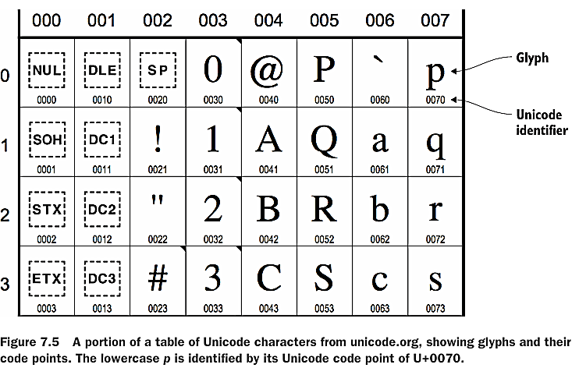

Slide 30
Best Practices
Test and Verify: After subsetting fonts, thoroughly test your website to ensure that all required characters and glyphs are displayed correctly. Pay attention to multilingual content and special characters that may be used in various contexts.
Regular Updates: If your website's content evolves or expands to include additional characters or languages, update the font subset accordingly to maintain optimal performance and support for new content.
Monitor Performance: Continuously monitor your website's performance metrics, including page load times and font loading behavior, to identify areas for improvement and optimization
In conclusion, subsetting fonts is a crucial technique for web performance optimization, enabling faster load times, reduced bandwidth consumption, and improved user experience. By selectively including only the necessary characters and glyphs, you can streamline font files and enhance the efficiency of your website's typography.

Slide 31
Compressing EOT and TTF font formats
Compressing EOT (Embedded OpenType) and TTF (TrueType Font) formats is a common practice in web development to optimize performance.
By reducing the file size of fonts, you can improve loading times and overall site performance.
To compress EOT (Embedded OpenType) and TTF (TrueType Font) files for serving via an Apache server in XAMPP, you can utilize gzip compression, which is a standard method for reducing file sizes over HTTP. Here's how you can enable compression for these file types in Apache:

Slide 32

Compression in Xampp

Slide 33
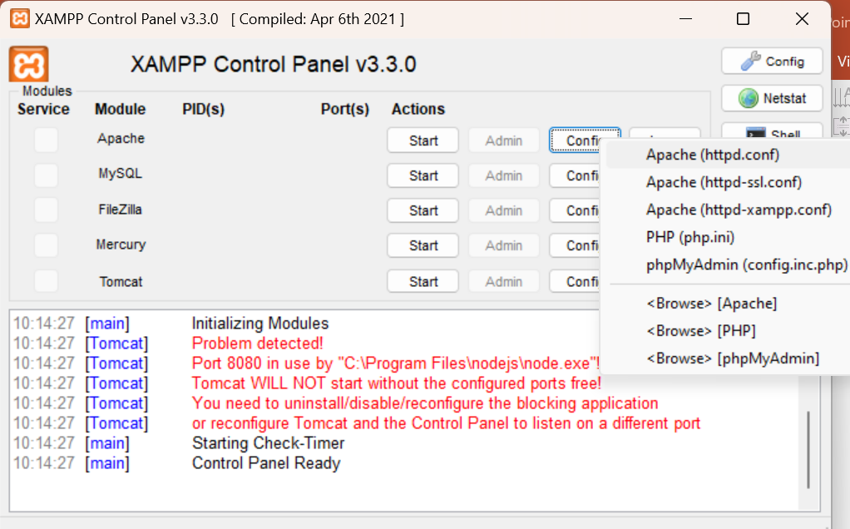

Enable mod_deflate module: This module allows Apache to compress content before sending it to the client. In XAMPP, this module is usually already enabled, but it's worth checking to ensure it's active.
To enable it, you can navigate to your Apache configuration file (httpd.conf) and ensure that the following line is not commented out:
LoadModule deflate_module modules/mod_deflate.so and mod_filter.so
If it's commented out (preceded by a #), remove the # to enable it.

Slide 34
Configure compression rules: You need to specify which file types you want to compress and what compression method to use. In this case, you want to compress EOT and TTF files.
Inside your Apache configuration file (httpd.conf), or preferably in a .htaccess file if you want to apply these rules to a specific directory, you can add the following lines:
<IfModule mod_deflate.c>
<FilesMatch "\.(ttf|eot)$">
SetOutputFilter DEFLATE
Header append Vary Accept-Encoding
</FilesMatch>
</IfModule>

Slide 35
This configuration will enable compression for .ttf and .eot files.
The SetOutputFilter DEFLATE line instructs Apache to compress the specified file types using the DEFLATE method, and Header append Vary Accept-Encoding ensures that proxies and browsers cache the compressed content correctly.
Restart Apache: After making these changes, you'll need to restart the Apache server for the changes to take effect. You can do this through the XAMPP Control Panel.

Slide 36
Optimizing the loading of fonts
Loading any asset on a website involves pitfalls that vary based on the asset’s type.
For instance, loading CSS with the <link> tag blocks rendering until the style sheet is downloaded and parsed and the styles are applied to the document.
<script> tags that reference external JavaScript files similarly block rendering of the page when they’re placed toward the top of the document.
Fonts are no different, and loading them causes no shortage of issues that can have ramifications on the readability of your site.

Slide 37
Understanding font-loading problems
The Legendary Tones owners have sent an email saying that, although they’re happy with the way the fonts look, they’re noticing that text on the page seems to take a while to render on slow connections.
This is understandable, but the reality is that this is how some browsers work when it comes to downloading fonts. The phenomenon the client is referring to is called the Flash of Invisible Text.
Flash of Invisible Text is similar to the Flash of Unstyled Content (FOUC) anomaly, only instead of unstyled content, you’re dealing with text being invisible until the document’s fonts are fully loaded.
It’s noticeable on even fast connections if you pay close attention. As connection speed decreases and network latency increases, the problem becomes more evident.
Mobile devices on slow mobile networks such as 2G and 3G are more susceptible to this phenomenon.
You can see this problem in figure 7.12 that follows.

Slide 38
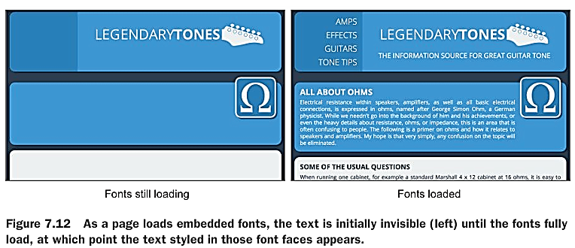
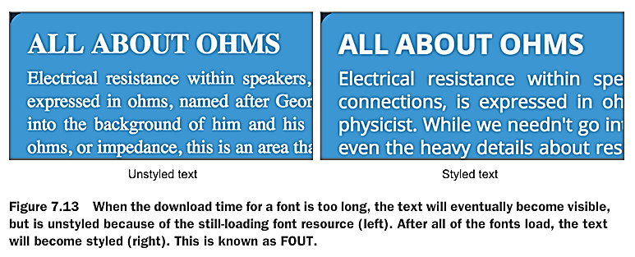

Slide 39
Font-Loading Problems:
Render Blocking: If web fonts are not loaded efficiently, they can block the rendering of text content on a page, leading to delayed visual completion.
Flash of Invisible Text (FOIT): This occurs when the browser delays rendering text until the custom font is fully loaded. During this delay, users may see default system fonts or even blank spaces, which can result in a poor user experience.
Flash of Unstyled Text (FOUT): In contrast to FOIT, FOUT occurs when the browser initially renders text with fallback fonts and then switches to the custom font once it's loaded. While less jarring than FOIT, FOUT can still disrupt the visual consistency of the page.
Performance Overhead: Loading multiple web fonts or large font files can increase page load times and consume additional bandwidth, especially on mobile devices and slower network connections.

Slide 40
Strategies for Font-Loading Optimization:
Font Preloading: Use the preload attribute to instruct the browser to fetch fonts early in the page load process, reducing the likelihood of render-blocking delays. This can be achieved by adding <link rel="preload"> elements to the HTML head section.
Font Subsetting: Reduce font file sizes by including only the characters and styles needed for your website. Font subsetting tools can help minimize file sizes and improve loading times.
Font Display Swap: Implement the font-display: swap; CSS property to instruct the browser to use fallback fonts immediately and switch to the custom font once it's available. This helps mitigate FOIT and FOUT issues by ensuring that text remains visible while the custom font loads.

Slide 41
Host Fonts Locally or Use a CDN: Hosting fonts locally on your server or using a Content Delivery Network (CDN) can improve loading times by ensuring that fonts are served from a location that's physically closer to your users. CDNs are optimized for delivering content quickly and can help reduce latency.
Preload Fonts: Use the preload attribute in your HTML to instruct the browser to prioritize downloading critical fonts early in the page load process. This ensures that fonts are available when needed, reducing the likelihood of a Flash of Invisible Text (FOIT) or Flash of Unstyled Text (FOUT).

Slide 42
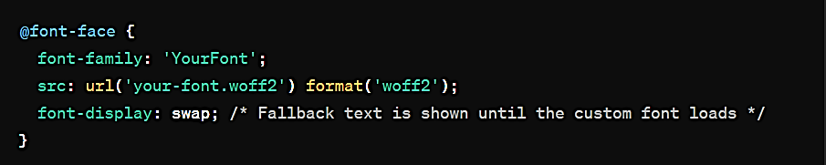
Specify Font Display Behavior: Use the font-display property in your CSS to control how fonts are displayed while they're loading. This property allows you to specify fallback behavior if the font is not yet available.

Slide 43
Optimize Font Loading Sequence: Place font loading CSS in the document <head> to ensure fonts start downloading as early as possible. However, avoid render-blocking CSS that could delay the rendering of content. You can achieve this by inlining critical CSS and deferring non-critical CSS.
Monitor Font Performance: Use web performance monitoring tools like Lighthouse, WebPageTest, or browser developer tools to analyze font loading performance and identify areas for improvement. These tools can provide insights into loading times, rendering behavior, and potential bottlenecks.
Consider System Fonts: Using system fonts as fallback options can improve performance, especially for text content. System fonts are already available on users' devices and load instantly, reducing the need to download custom fonts. However, system fonts may not provide the exact styling you desire.

Slide 44
Keeping JavaScript lean and fast
Affecting script-loading behaviour as with the <link> tag when loading CSS, the <script> tag can hinder the rendering of a page, depending on the tag’s placement in the document. You can also modify script-loading behavior via the element’s async attribute.
Placing the <script> element properly.
The <script> tag is responsible for this same kind of behavior as well, but because scripts don’t impact the appearance of a page like CSS imports, you have more flexibility in placing <script> tags.

Slide 45
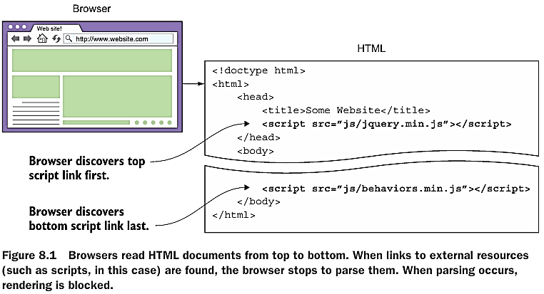

Slide 46
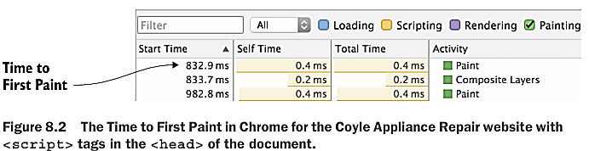
To measure the Time to First Paint for the client’s website, select the Regular 3G throttling profile to simulate page loading on a slower connection.
Then go to the Timeline tab and head to http://localhost:8080. When the page loads and the timeline populates, go to the bottom of the Timeline pane and switch to the Event Log tab.
Once there, filter out all event types except for painting events. The first event to appear in the list is the Time to First Paint, which should look something like figure 8.2.

Slide 47
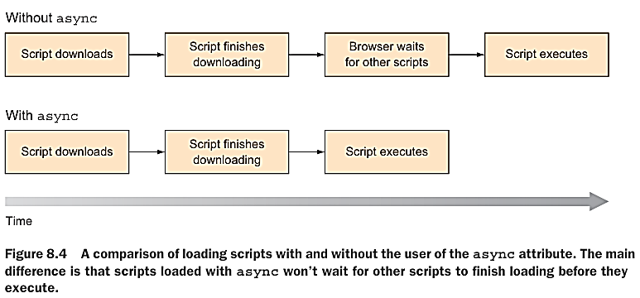
Working with asynchronous script loading
Modern browsers support a method for changing the loading behavior of external scripts. This change is via the <script> tag’s async attribute. async (short for asynchronous) tells the browser to execute a script as soon as it loads, rather than loading each script in order and waiting to execute them in sequence.

Slide 48
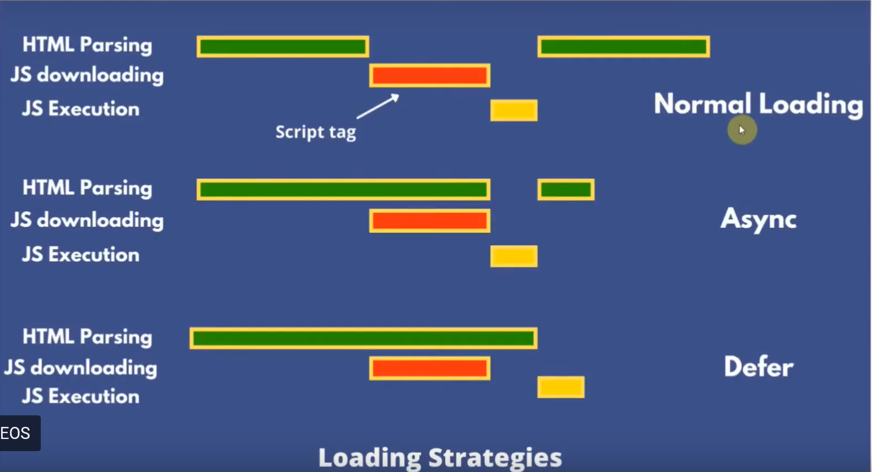

Slide 49
The async attribute in HTML <script> tags is used to indicate that the script file can be executed asynchronously, meaning it won't block the rendering of the page while it loads and executes. This attribute is particularly useful for scripts that are not dependent on each other or on the rendering of the page.
Here's how you would use the async attribute in a <script> tag:
<script src="script.js" async></script>
When the browser encounters this <script> tag with the async attribute, it will begin downloading the script file immediately, but it won't wait for it to finish downloading before continuing to parse and render the rest of the page. Once the script file is downloaded, it will be executed asynchronously with respect to the page rendering.

Slide 50
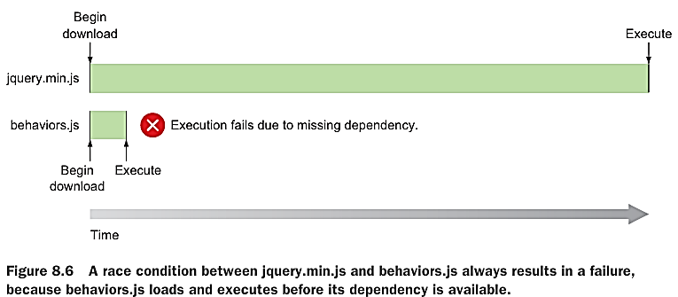
Using async:
To use async, add it to <script> tags that you want to execute asynchronously. In this case, doing this will slash your client website’s Time to First Paint by approximately 40%. When you use async with interdependent scripts, they enter into what’s called a race condition, where two scripts can run out of sequence. In this example, a race condition occurs between jquery.min.js and behaviors.js. Because behaviors.js is much smaller than jquery.min.js, it’ll always win the race and run first. Because behaviors.js is dependent on jquery.min.js, behaviors.js will always fail due to an unavailable jQuery object. This is because jquery.min.js hasn’t loaded and executed before behaviors.js does.

Slide 51
If none of your scripts have dependencies, you can use async freely. It’s when scripts have dependencies that things get tricky.
A way of getting around this is to combine your dependent scripts so that those dependencies are wrapped into a single asset.
In this case, you can combine jquery.min.js and behaviors.js, in that order.
From your command line, you can run this command to combine both scripts into scripts.js:
type jquery.min.js behaviors.js > scripts.js
This command will finish quickly, and when it does, you get rid of both.
<script src="js/scripts.js" async></script>

Slide 52
It's important to note that scripts with the async attribute can be executed in any order relative to each other or to the loading of the page.
If the order of execution or dependencies between scripts is crucial, you may want to use the defer attribute instead, which ensures that scripts are executed in the order they appear in the HTML document, after the document has been parsed.
Without defer attribute:
<!DOCTYPE html>
<head>
<title>Script Example</title>
</head>
<body>
<!-- Including script1.js without defer -->
<script src="script1.js“ async></script>
<!-- Including script2.js without defer -->
<script src="script2.js“ ></script>
</body>
</html>
In this case, the browser will start downloading script1.js and script2.js sequentially. However, it might execute script2.js before script1.js has finished executing, potentially causing issues due to the dependency between the scripts.

Slide 53
With defer attribute:
<!DOCTYPE html>
<head>
<title>Script Example</title>
</head>
<body>
<!-- Including script1.js with defer -->
<script src="script1.js" defer></script>
<!-- Including script2.js with defer -->
<script src="script2.js" ></script>
</body>
</html>
With the defer attribute, both script1.js and script2.js will be downloaded asynchronously but executed in order after the HTML document has been parsed. So, in this case, script1.js will always execute before script2.js, ensuring that the dependency between the scripts is properly handled.

Slide 54
While both the async and defer attributes can be used with the <script> tag, it's generally not recommended to use them together.
async allows the script to be downloaded asynchronously and executed as soon as it's available, potentially out of order.
defer downloads the script asynchronously but ensures that it's executed in order after the HTML document has been parsed.

Slide 55
Using leaner jQuery-compatible alternatives
Many JavaScript libraries are jQuery-compatible. jQuery-compatible doesn’t mean that every single jQuery method is provided in these alternatives; it means that numerous methods present in jQuery are available in the alternative, and with the same syntax.
The idea is that some measure of file size is traded off for less functionality.
jQuery has been a popular JavaScript library for simplifying DOM manipulation and AJAX requests for many years.
However, as modern web development has evolved, the need for jQuery has reduced due to the improvements in native JavaScript and the introduction of modern frameworks and libraries.

Slide 56
Exploring the contenders
Vanilla JavaScript:
Vanilla JavaScript refers to using native JavaScript without any additional libraries or frameworks.
With the introduction of modern JavaScript features and improved browser compatibility, many tasks that previously required jQuery can now be accomplished using plain JavaScript.
Vanilla JavaScript is lightweight, fast, and doesn't require any external dependencies, making it a leaner alternative to jQuery.
Developers can leverage modern APIs like querySelector, addEventListener, and fetch for DOM manipulation, event handling, and AJAX requests respectively.

Slide 57
Zepto.js:
Zepto.js is a lightweight, jQuery-compatible library designed for modern browsers and mobile devices.
It provides a similar API to jQuery but focuses solely on DOM manipulation and AJAX requests, making it much smaller in size.
Zepto.js is particularly suited for mobile web development due to its small footprint and compatibility with touch events.
However, Zepto.js lacks some of the advanced features and extensive plugin ecosystem of jQuery.

Slide 58
Cash:
Cash is another lightweight jQuery-compatible library inspired by Zepto.js but with a smaller footprint.
It aims to provide a subset of jQuery's functionality in a more efficient manner.
Cash is compatible with modern browsers and offers a familiar jQuery-like API for DOM manipulation and traversal.
It's optimized for size and performance, making it ideal for projects where minimizing library overhead is crucial.

Slide 59
Umbrella.js:
Umbrella.js is a minimalist jQuery-compatible library that focuses on providing essential DOM manipulation and traversal functions.
It aims to offer a lightweight alternative to jQuery while maintaining compatibility with its API.
Umbrella.js is designed to be modular, allowing developers to include only the parts they need, further reducing its footprint.
Despite its small size, Umbrella.js provides a robust set of features for common tasks like selecting elements, handling events, and making AJAX requests.

Slide 60
Alpine.js:
Alpine.js takes a different approach compared to traditional libraries like jQuery.
It's a minimal framework for declaratively managing JavaScript behavior directly in HTML using attributes.
Alpine.js is well-suited for building interactive components and adding dynamic behavior to static web pages without the need for complex JavaScript code.
While not strictly a jQuery alternative, Alpine.js can be used to achieve similar functionality in a more modern and lightweight manner.

Slide 61
Getting by without jQuery
Getting by without jQuery involves understanding modern web development practices and utilizing native JavaScript features and APIs.
jQuery was once a dominant library used to simplify JavaScript programming, especially for DOM manipulation and event handling.
However, with advancements in web standards and browser support, many of the features provided by jQuery are now available in native JavaScript.
jQuery and its alternatives are great, but many methods have been implemented (or are being implemented) into browsers that provide much of the same functionality.
Tasks such as element selection and event binding that were once a burden to write for cross-browser compatibility now have a unified syntax, thanks to tstandardization efforts.

Slide 62
Checking for the DOM to be ready
Checking for the Document Object Model (DOM) to be ready is a crucial aspect of web development, especially when JavaScript interacts with the DOM elements.
The DOM represents the structure of a document (typically HTML or XML) and provides a structured representation of it, allowing programs to manipulate its content, structure, and style.
When a web page loads, the browser constructs the DOM based on the HTML markup received from the server.
However, JavaScript often needs to interact with DOM elements, and it's essential to ensure that the DOM is fully loaded and ready for manipulation before executing JavaScript code that relies on DOM elements.
There are several methods to check if the DOM is ready in JavaScript. Here are a few common techniques:

Slide 63
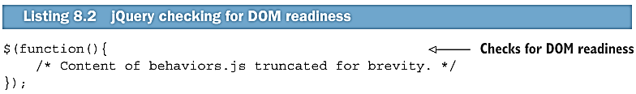
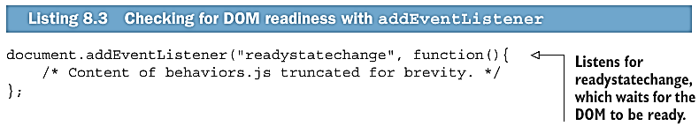

Slide 64
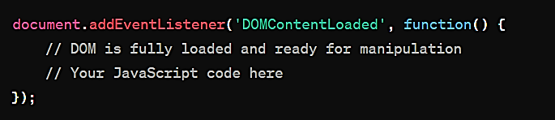
DOMContentLoaded Event: This event fires when the initial HTML document has been completely loaded and parsed, without waiting for stylesheets, images, and subframes to finish loading. You can use it to execute JavaScript once the DOM is ready. Example:

Slide 65
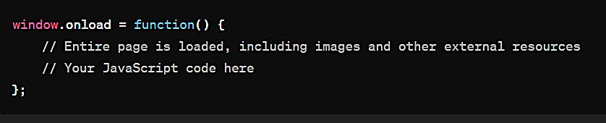
window.onload Event: This event fires when all resources (including images and other external files) have been completely loaded. It indicates that the entire page, including its external resources, is ready. Example:

Slide 66
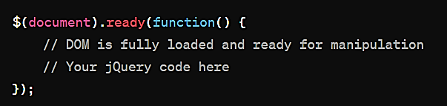
jQuery's $(document).ready(): If you're using jQuery, you can use its $(document).ready() method to execute code when the DOM is ready. Example:

Slide 67
Animating with requestAnimationFrame

